Slide 1
Software Engineering Unit-II
Prepared by: Neha Tripathi

Slide 2
Software Requirement Validation

Slide 3
Requirement Engineering Process
- Requirement Elicitation and Analysis
- Software Requirement Specification
- Software Requirement Validation
- Software Requirement Management

Slide 4
Requirements Validation
Requirements validation is the process of checking the requirements for validity, consistency, completeness, realism and verifiability.
Concerned with demonstrating that the requirements define the system that the customer really wants.
Requirements error costs are high so validation is very important
Fixing a requirements error after delivery may cost up to 100 times the cost of fixing an implementation error.

Slide 5
Requirements checking
Validity. Does the system provide the functions which best support the customer’s needs?
Consistency. Are there any requirements conflicts?
Completeness. Are all functions required by the customer included?
Realism. Can the requirements be implemented given available budget and technology
Verifiability. Can the requirements be checked?

Slide 6
Requirements validation techniques
Requirements reviews
Systematic manual analysis of the requirements.
Prototyping
Using an executable model of the system to check requirements.
Test-case generation
Developing tests for requirements to check testability.

Slide 7
Requirements Reviews
Regular reviews should be held while the requirements definition is being formulated.
Both client and contractor staff should be involved in reviews.
Reviews may be formal (with completed documents) or informal. Good communications between developers, customers and users can resolve problems at an early stage.

Slide 8
Review checks
Verifiability
Is the requirement realistically testable?
Comprehensibility
Is the requirement properly understood?
Traceability
Is the origin of the requirement clearly stated?
Adaptability
Can the requirement be changed without a large impact on other requirements?

Slide 9
Software Requirement Management

Slide 10
Requirement Engineering Process
- Requirement Elicitation and Analysis
- Software Requirement Specification
- Software Requirement Validation
- Software Requirement Management

Slide 11
Requirements Management
Requirements management is the process of managing changing requirements during the requirements engineering process and system development.
Business, organizational and technical changes inevitably lead to changes to the requirements for a software system. Requirements management is the process of managing and controlling these changes.
New requirements emerge as a system is being developed and after it has gone into use.
You need to keep track of individual requirements and maintain links between dependent requirements so that you can assess the impact of requirements changes. You need to establish a formal process for making change proposals and linking these to system requirements.

Slide 12
Changing requirements
The business and technical environment of the system always changes after installation.
The people who pay for a system and the users of that system are rarely the same people.
Large systems usually have a diverse user community, with many users having different requirements and priorities that may be conflicting or contradictory.

Slide 13
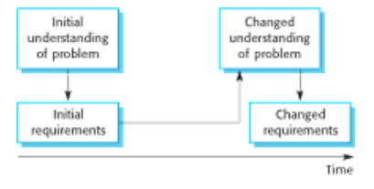
Requirements evolution

Slide 14
Requirements management planning
Establishes the level of requirements management detail that is required.
Requirements management decisions:
Requirements identification Each requirement must be uniquely identified so that it can be cross-referenced with other requirements.
A change management process This is the set of activities that assess the impact and cost of changes. I discuss this process in more detail in the following section.
Traceability policies These policies define the relationships between each requirement and between the requirements and the system design that should be recorded.
Tool support Tools that may be used range from specialist requirements management systems to spreadsheets and simple database systems.

Slide 15
Deciding if a requirements change should be accepted
Problem analysis and change specification
During this stage, the problem or the change proposal is analyzed to check that it is valid. This analysis is fed back to the change requestor who may respond with a more specific requirements change proposal, or decide to withdraw the request.
Change analysis and costing
The effect of the proposed change is assessed using traceability information and general knowledge of the system requirements. Once this analysis is completed, a decision is made whether or not to proceed with the requirements change.
Change implementation
The requirements document and, where necessary, the system design and implementation, are modified. Ideally, the document should be organized so that changes can be easily implemented.

Slide 16
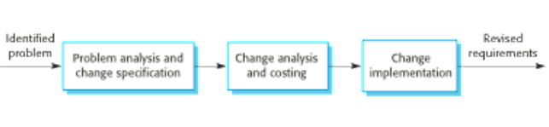
Requirements Change Management

Slide 17
Thank You!

